Slide 1


Short Term Rentalz Summit 2025
The State of the Short Term Rentals Market
5th November 2025
Prepared by Key Data Dashboard™ | © KEY DATA DASHBOARD

Slide 2


Slide 3






Short term rentals
Changing trends
The Age of Brochures
The Instant Traveller
No room at the inn…
Demand for alternative accommodation..
Printed ads and brochures…
Prices set in advance, lead times longer, durations standard.
Information on demand…
Tech stacks, dynamic pricing, regulations, OTAs.. shorter lead times and stays

Slide 4
Agenda
The Age of Brochures
The Instant Traveller
The Big Picture : How Far We’ve Come
  Guest occupancy, ADR, RevPAR
The Changing Traveller: What Guests Want Now
  Length of Stay
  Booking Windows
  Channel Shifts
Europe at the Heart of the Story
  Italy, Spain, Portugal, France, Greece, Denmark, United Kingdom
The Turning Tide of Travel, Events, and Portfolios
The Final Chapter

Slide 5




Slide 6
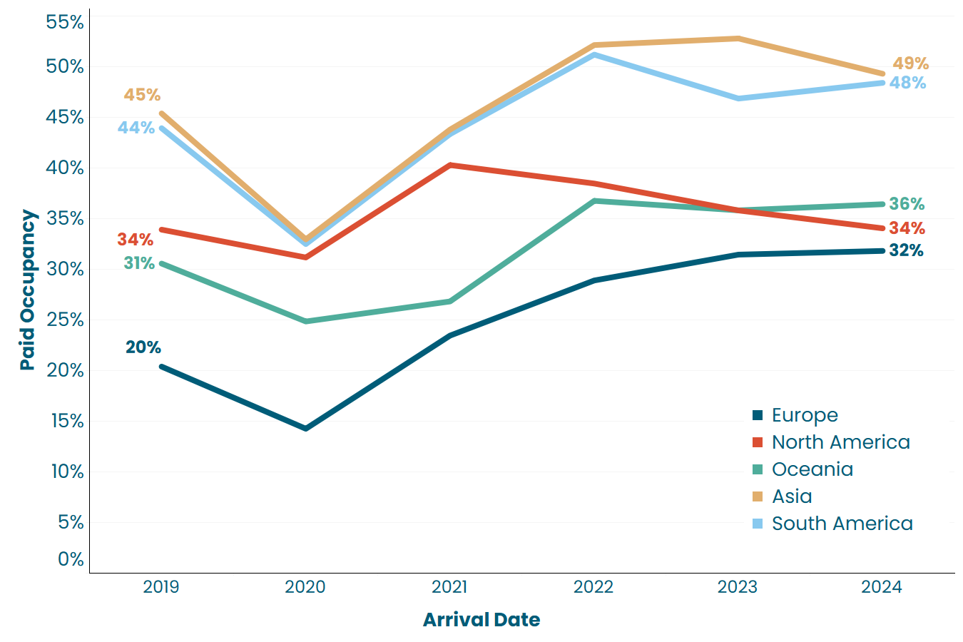
The big picture
Guest paid occupancy
FLAT (+/-)
Europe is continuing to deliver marginal growth
US continues to be under pressure but has steadied
Pacing: All except South America pacing flat or slightly up on 2024
The Age of Brochures
The Instant Traveller
2025 Pacing
+2%
-1%
+1%
+0%
+2%
Key Data direct clients, confirmed bookings @ 20th October 2025

Slide 7
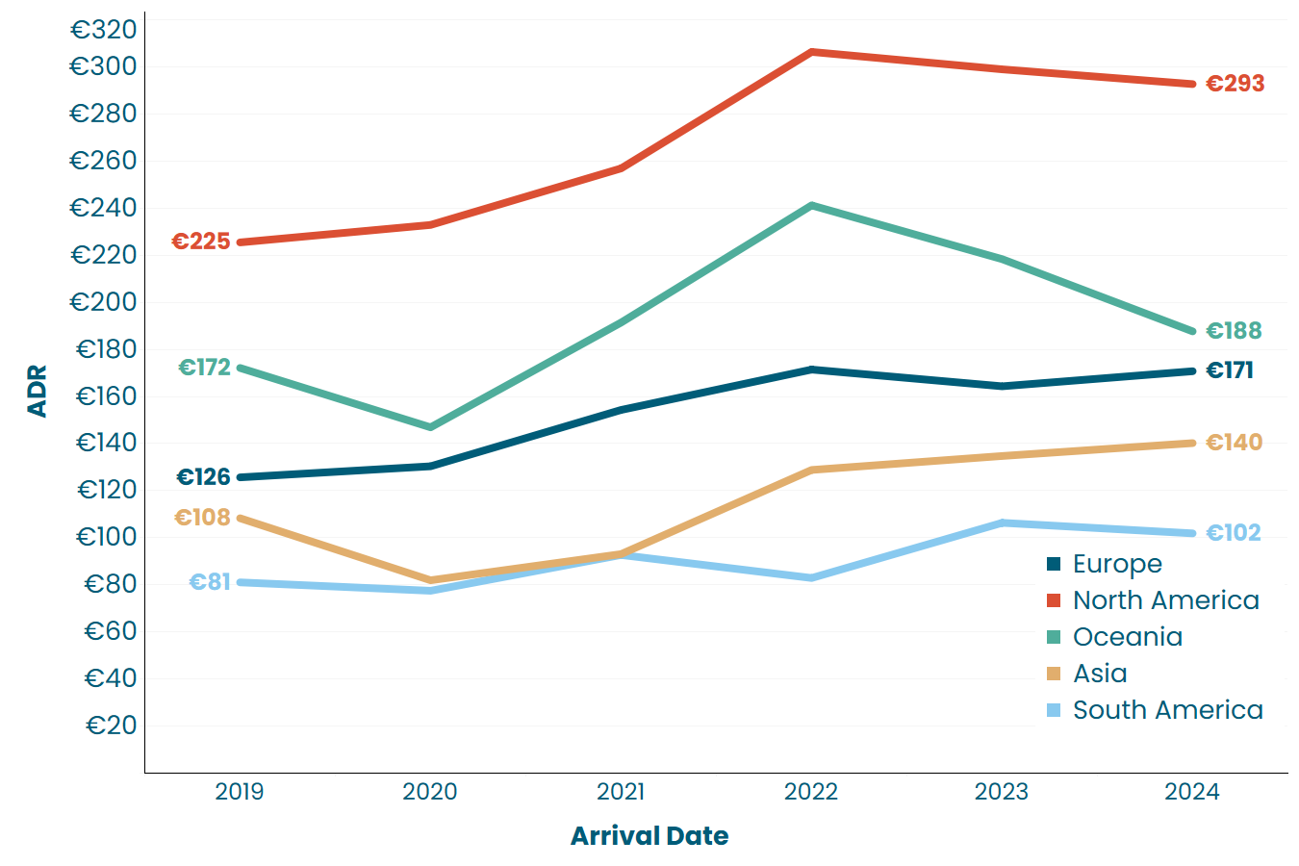
The big picture
Rates_Average Daily Rates
Marginal rate growth in Europe and Asia until 2024
Rest of the world saw pressure on rates
Pacing: Europe and Oceania showing positive rate growth but the rest pacing down on last year.
2025 Pacing
-2%
+1%
+1%
-1%
-1%
The Age of Brochures
The Instant Traveller
Key Data direct clients, confirmed bookings @ 20th October 2025

Slide 8
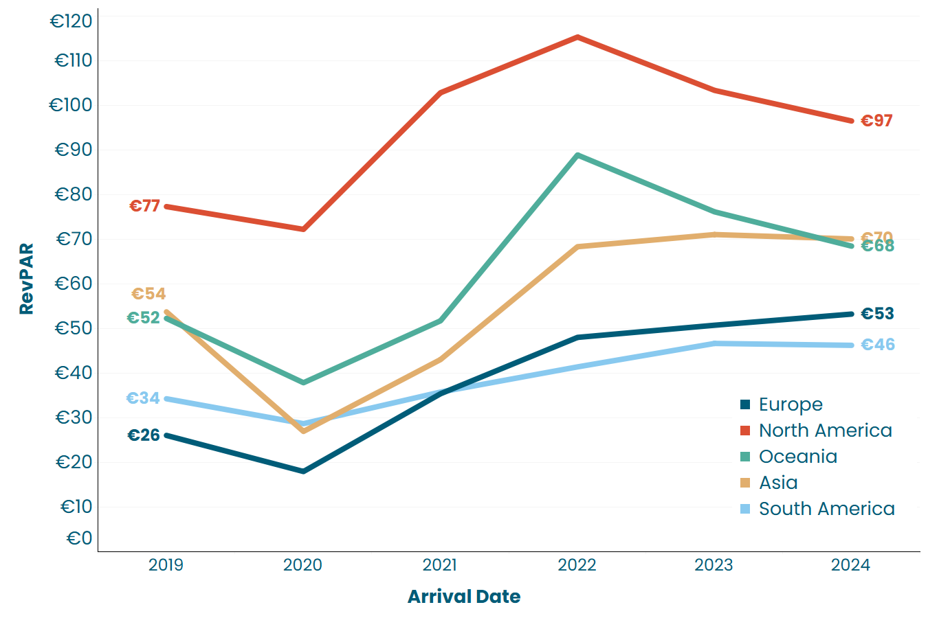
The big picture
RevPAR
The Age of Brochures
The Instant Traveller
2025 Pacing
-1%
-1%
+1%
+1%
-1%
Marginal RevPAR growth in Europe and Asia
South America pushing positive RevPAR due to occupancy growth
Rest of the world is seeing negative RevPAR
Pacing: Europe and Oceania pacing ahead, all others pacing behind
Key Data direct clients, confirmed bookings @ 20th October 2025

Slide 9
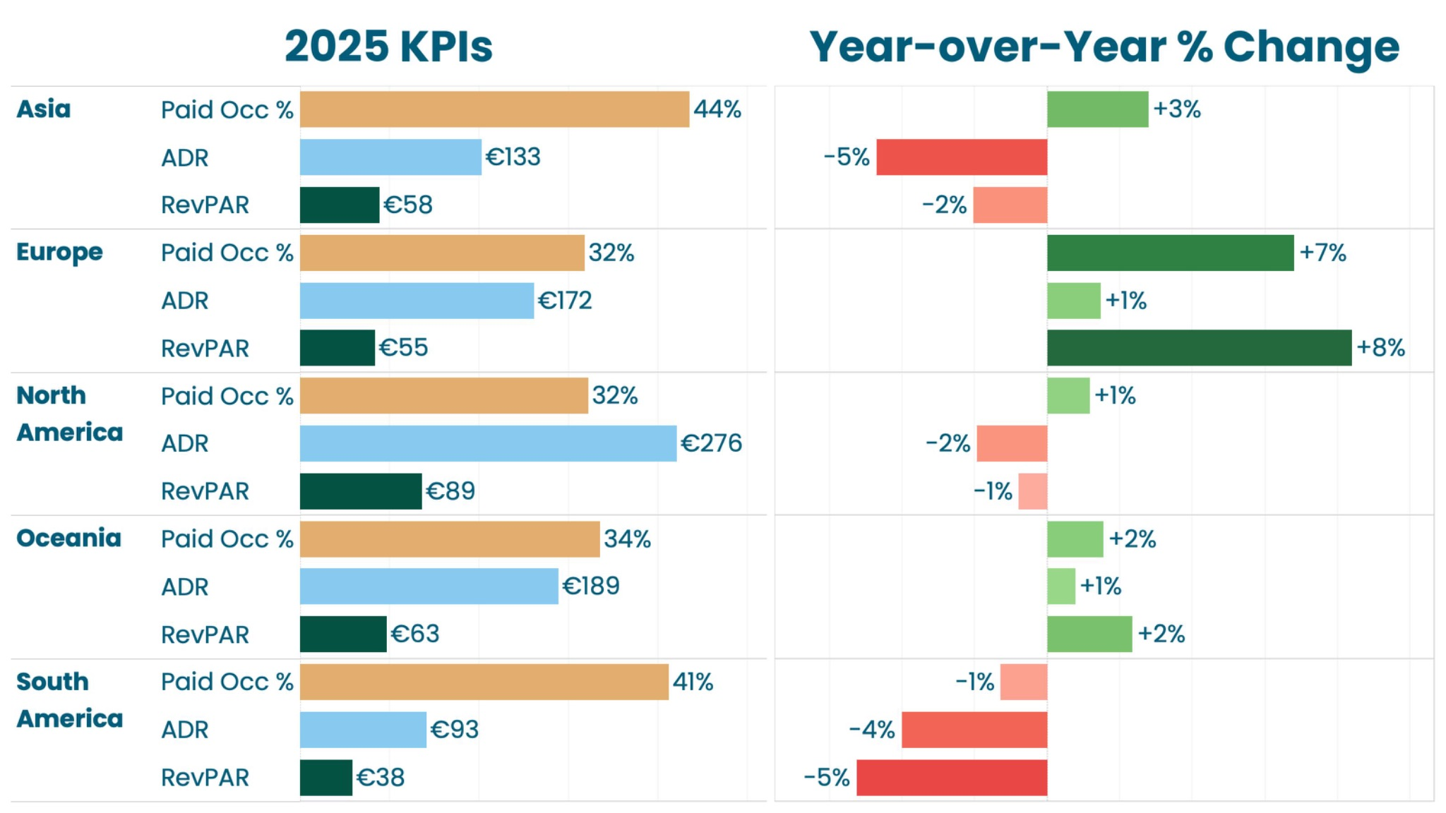
The big picture
2025 V 2024
The Age of Brochures
The Instant Traveller
Annual pacing is seeing higher occupancy and rates in both Europe and Oceania. +RevPAR.
South America has softer occupancy and rates -RevPAR
North America is pretty flat
Asia - occupancy growth not offsetting softer rates -RevPAR
Q4 Pacing, RevPAR: Europe, pacing +10%, Oceania +12%.
South America: -11%
Key Data direct clients, confirmed bookings @ 20th October 2025

Slide 10



Slide 11
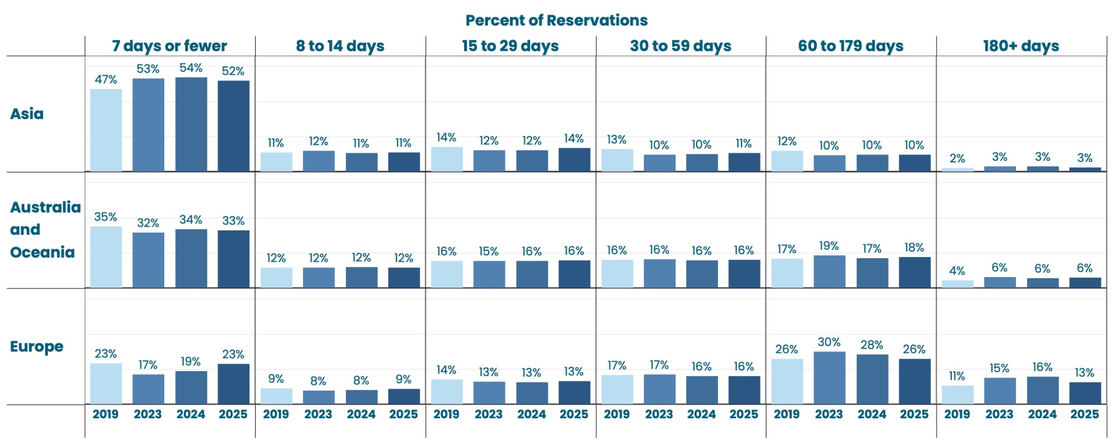
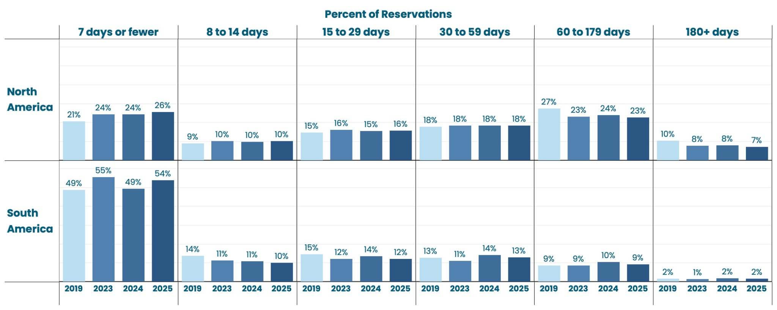
The Changing Traveller
Booking window
The Age of Brochures
The Instant Traveller
An increase in the number of bookings confirmed to depart within 7 days
Bookings made 60+ days out is shrinking
Key Data direct clients, confirmed bookings @ 20th October 2025

Slide 12
The Changing Traveller
Booking window
Almost 1 in 4 bookings are made to arrive within 7 days (Europe and the US).
Europe still sees the highest % of reservations in the 60 -179 days category
The Age of Brochures
The Instant Traveller
Key Data direct clients, confirmed bookings @ 20th October 2025

Slide 13
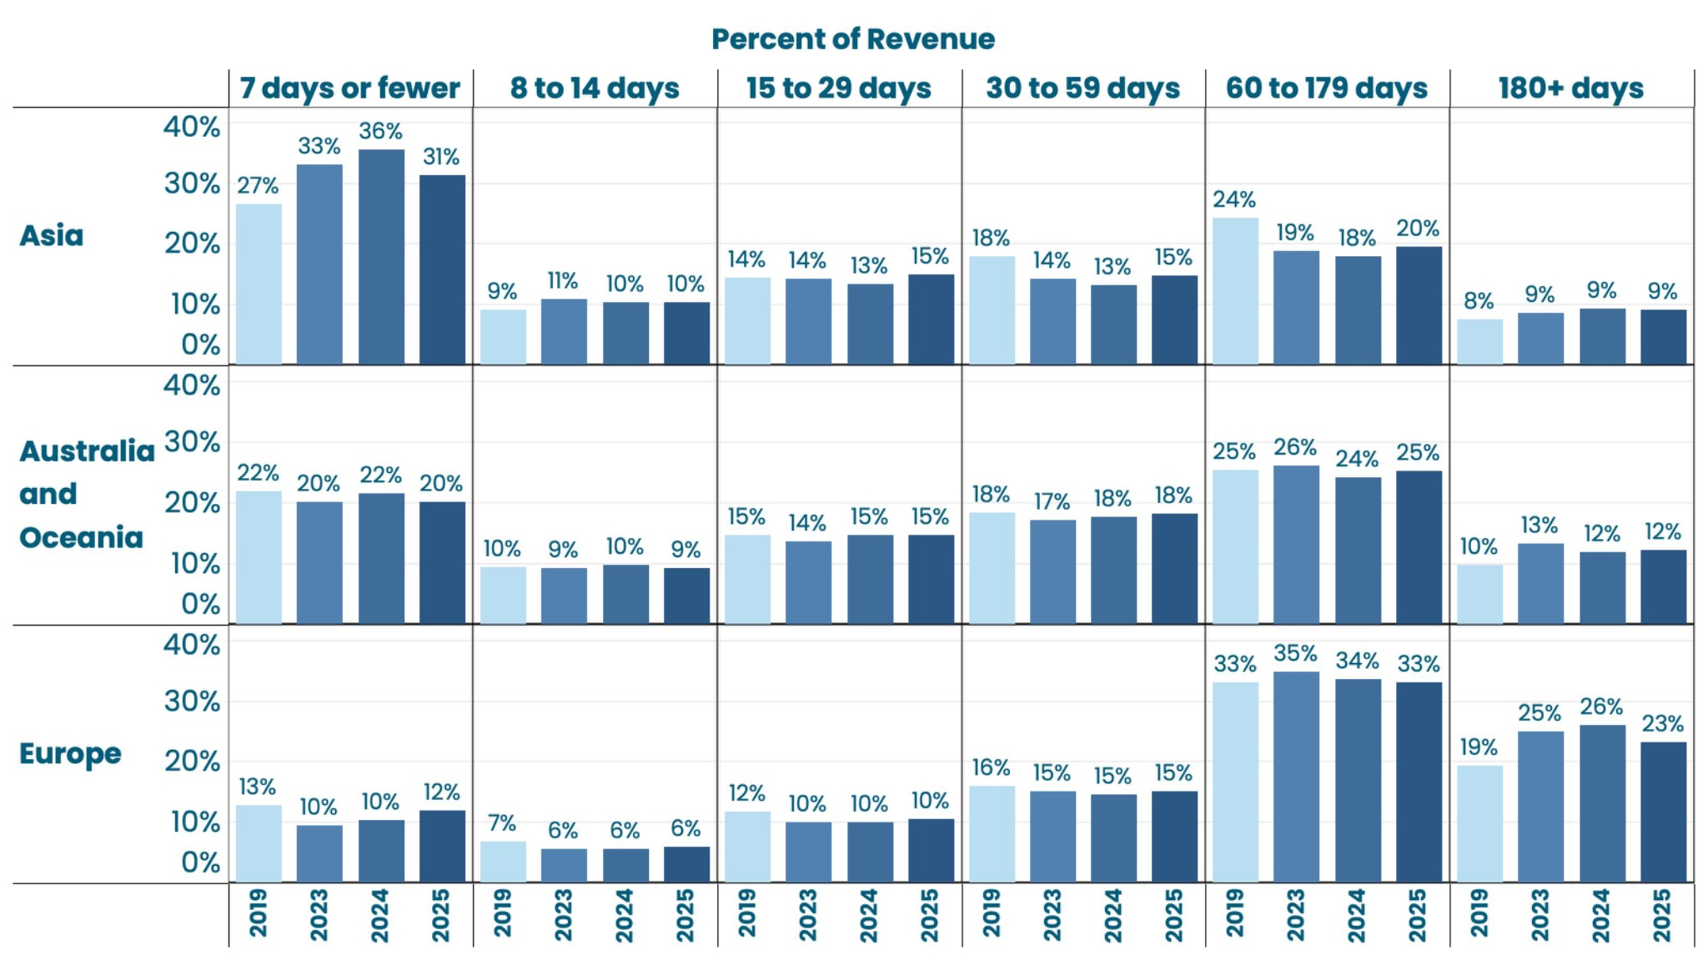
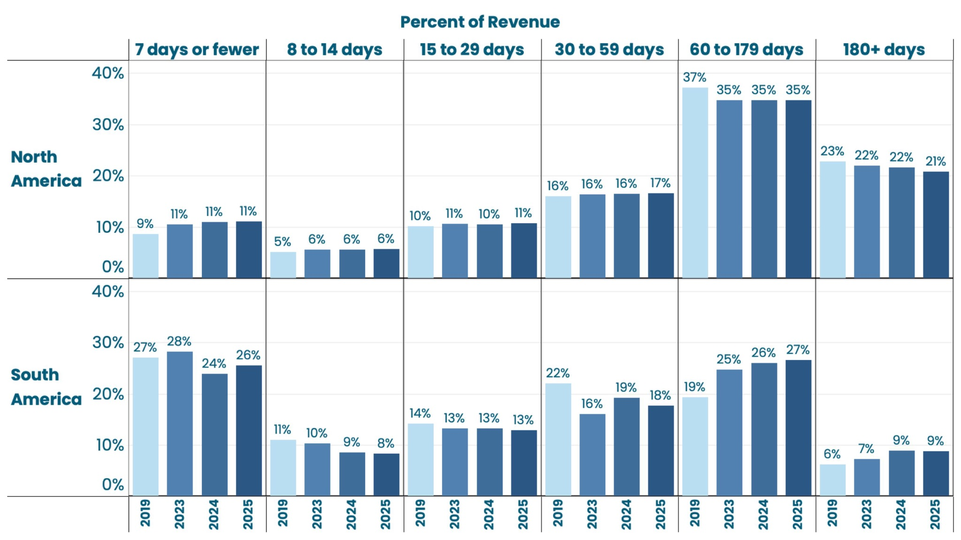
The Changing Traveller
Booking window
The Age of Brochures
The Instant Traveller
Less than 7 days
23% of reservations:
12% of revenue (Eur)
26% of reservations:
11% of revenue (US)
60 - 179 days
26% of reservations:
33% of revenue (Eur)
23% of reservations:
35% of revenue (US)
Key Data direct clients, confirmed bookings @ 20th October 2025

Slide 14
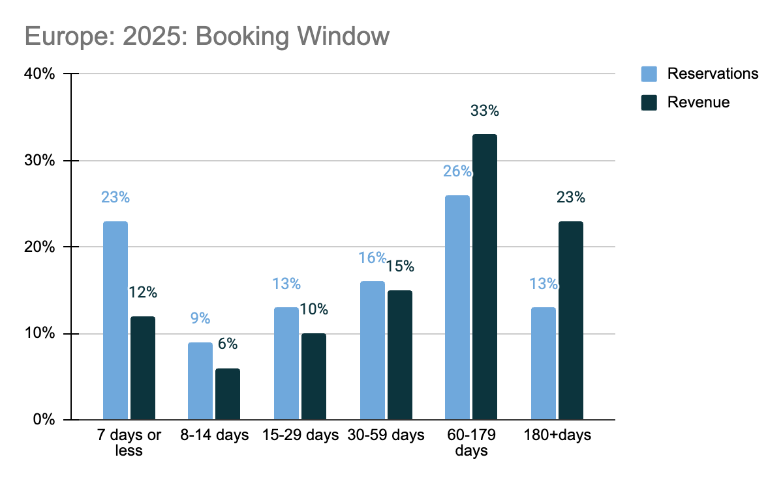
The Changing Traveller
Booking window
The Age of Brochures
The Instant Traveller
Strong correlation between Reservation Lead Time and Revenue
Impact on revenue as we see this later booking trend
Key Data direct clients, confirmed bookings @ 20th October 2025

Slide 15
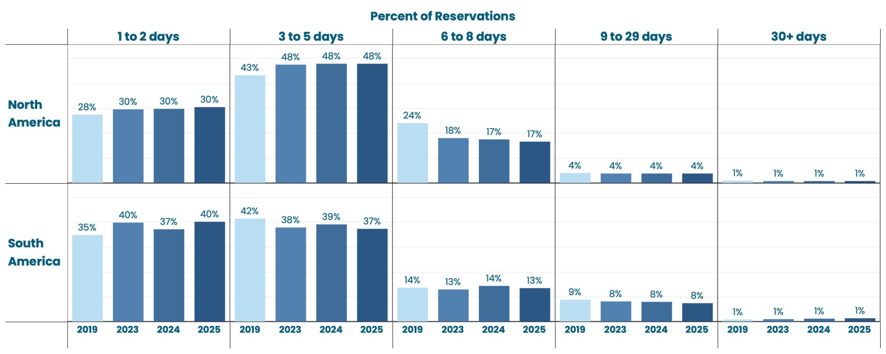
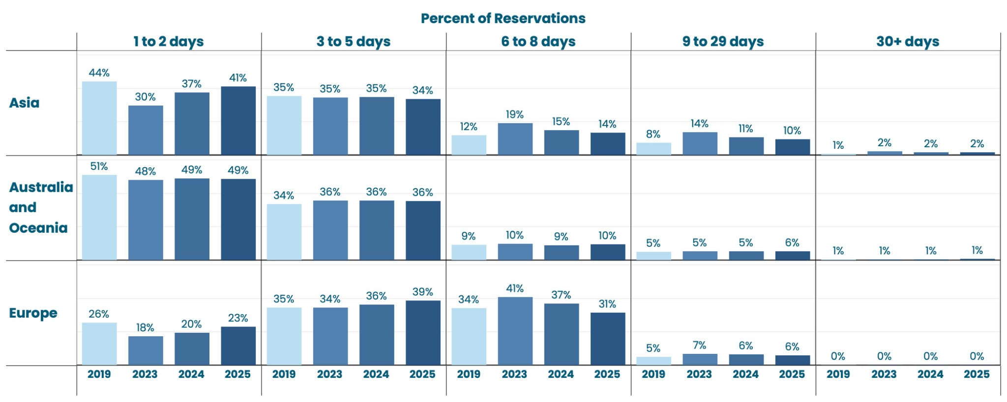
The Changing Traveller
Booking window
The Age of Brochures
The Instant Traveller
Stay lengths continue to contract in Europe.
US already seeing shorter stays
At the expense of the traditional 7 nights.
Key Data direct clients, confirmed bookings @ 20th October 2025

Slide 16
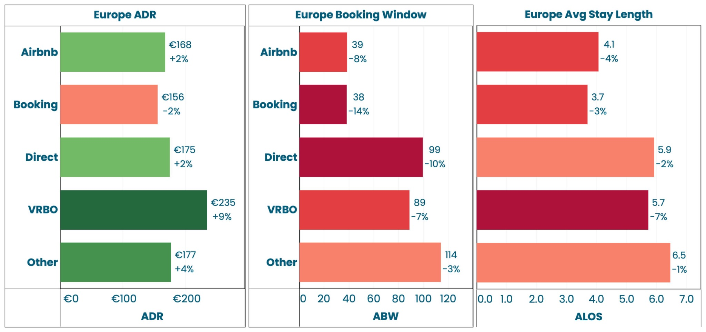
The Changing Traveller
Channel shifts: Europe
The Age of Brochures
The Instant Traveller
+2.7pp
+5.9pp
-2.6pp
+0.0pp
-5.8pp
Key Data direct clients, confirmed bookings @ 20th October 2025

Slide 17
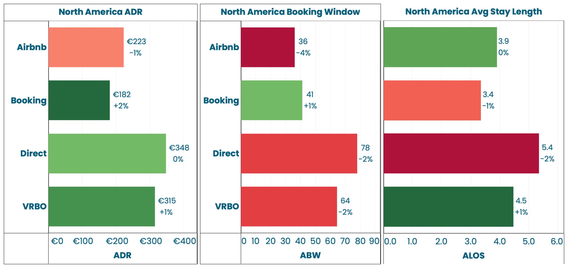
The Changing Traveller
Channel shifts: North America
The Age of Brochures
The Instant Traveller
+3.3pp
+0.1pp
-1.3pp
-2.0pp
Key Data direct clients, confirmed bookings @ 20th October 2025
Notes:
36% direct, 35% Airbnb, 25% Vrbo

Slide 18



Slide 19





Europe at the Heart of the Story
ITALY 2024 v 2025
+12%
-0.6%
CHANNEL SHIFT
Direct Airbnb Booking VRBO Other | +1.4pp +0.8pp +4.2pp -0.5pp -5.3pp
REVPAR
+11%
2024: €30
2025: €34
Paid Occupancy
ADR
2024 18% | 2025 20%
2024 172€ | 2025 171€
-14%
-17%
Length of Stay
Booking Window
2024 5.7 | 2025 4.9
2024 79 | 2025 66
2024 79 | 2025 66
Key Data direct clients, confirmed bookings @ 20th October 2025

Slide 20

Europe at the Heart of the Story
Spain 2024 v 2025
+5%
+3%
CHANNEL SHIFT
Direct Airbnb Booking VRBO Other | -0.2pp +4.7pp -2.1pp -0.5pp -2.0pp
REVPAR
+8%
2024: €51
2025: €55
Paid Occupancy
ADR
2024 34% | 2025 36%
2024 150€ | 2025 154€
-14%
-7%
Length of Stay
Booking Window
2024 6.27 | 2025 5.39
2024 51 | 2025 47
Key Data direct clients, confirmed bookings @ 20th October 2025

Slide 21

Europe at the Heart of the Story
Portugal 2024 v 2025
-8.2%
+9%
CHANNEL SHIFT
Direct Airbnb Booking VRBO Other | +1.6pp -1.7pp +2.5pp -0.8pp -1.6pp
REVPAR
FLAT
2024: €71
2025: €71
Paid Occupancy
ADR
2024 45% | 2025 41%
2024 158€ | 2025 172€
-27%
-14%
Length of Stay
Booking Window
2024 5.58 | 2025 4.17
2024 55 | 2025 47
Key Data direct clients, confirmed bookings @ 20th October 2025

Slide 22

Europe at the Heart of the Story
France 2024 v 2025
+12%
+6%
CHANNEL SHIFT
Direct Airbnb Booking VRBO Other | -0.5pp +2.2pp -1.1pp +0.1pp -0.8pp
REVPAR
+19%
2024: €46
2025: €55
Paid Occupancy
ADR
2024 25% | 2025 28%
2024 186€ | 2025 198€
-9%
-1.8%
Length of Stay
Booking Window
2024 5.0 | 2025 4.6
2024 46 | 2025 45
Key Data direct clients, confirmed bookings @ 20th October 2025

Slide 23

Europe at the Heart of the Story
Greece 2024 v 2025
+6%
+2%
CHANNEL SHIFT
Direct Airbnb Booking VRBO Other | +0.9pp +3.3pp -3.1pp -0.5pp -1.2pp
REVPAR
+8%
2024: €42
2025: €45
Paid Occupancy
ADR
2024 31% | 2025 33%
2024 135€ | 2025 138€
-0.5%
-2.7%
Length of Stay
Booking Window
2024 4.4 | 2025 4.3
2024 46 | 2025 45
Key Data direct clients, confirmed bookings @ 20th October 2025

Slide 24

Europe at the Heart of the Story
Denmark 2024 v 2025
+2.7%
+4.8%
CHANNEL SHIFT
Direct Airbnb Booking VRBO | -1.3pp +3.2pp +0.1pp -2.1pp
REVPAR
+7.7%
2024: €48
2025: €52
Paid Occupancy
ADR
2024 29% | 2025 30%
2024 166€ | 2025 174€
-2.7%
-3.6%
Length of Stay
Booking Window
2024 6.7 | 2025 6.6
2024 106 | 2025 103
Key Data direct clients, confirmed bookings @ 20th October 2025

Slide 25

Europe at the Heart of the Story
United Kingdom 2024 v 2025
+3%
+4%
CHANNEL SHIFT
Direct Airbnb Booking VRBO Other | -3.3pp +2.3pp +3.7pp +1.1pp -2.9pp
REVPAR
+7%
2024: €61
2025: €65
Paid Occupancy
ADR
2024 35% | 2025 36%
2024 175€ | 2025 182€
-3.6%
-6.7%
Length of Stay
Booking Window
2024 5.25 | 2025 5.06
2024 100 | 2025 93
Key Data direct clients, confirmed bookings @ 20th October 2025

Slide 26



Slide 27
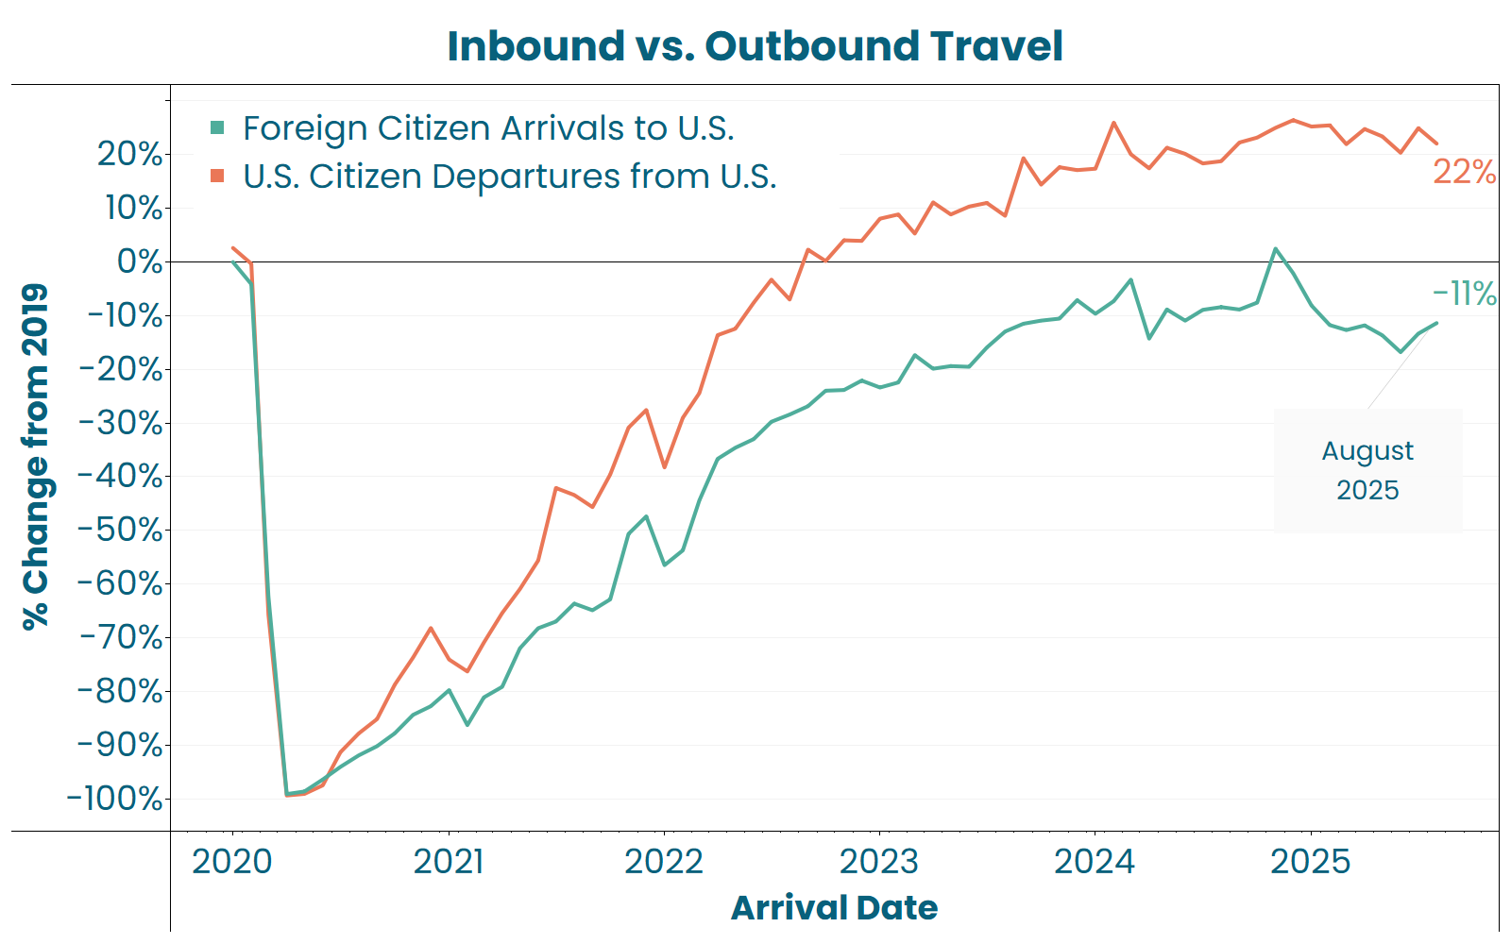
The Turning Tide of Travel
Shifts in travel patterns
The Age of Brochures
The Instant Traveller
Shifts in global travel patterns
The U.S. outbound recovery to 2019 remains strong with August 2025 up 22%.
Foreign arrivals to the U.S. returned briefly to 2019 levels, but since January 2025 have been worsening.
The continued gap between inbound and outbound travel highlights pressure on US domestic markets to compensate for reduced international visitors.
Key Data direct clients, confirmed bookings @ 20th October 2025

Slide 28
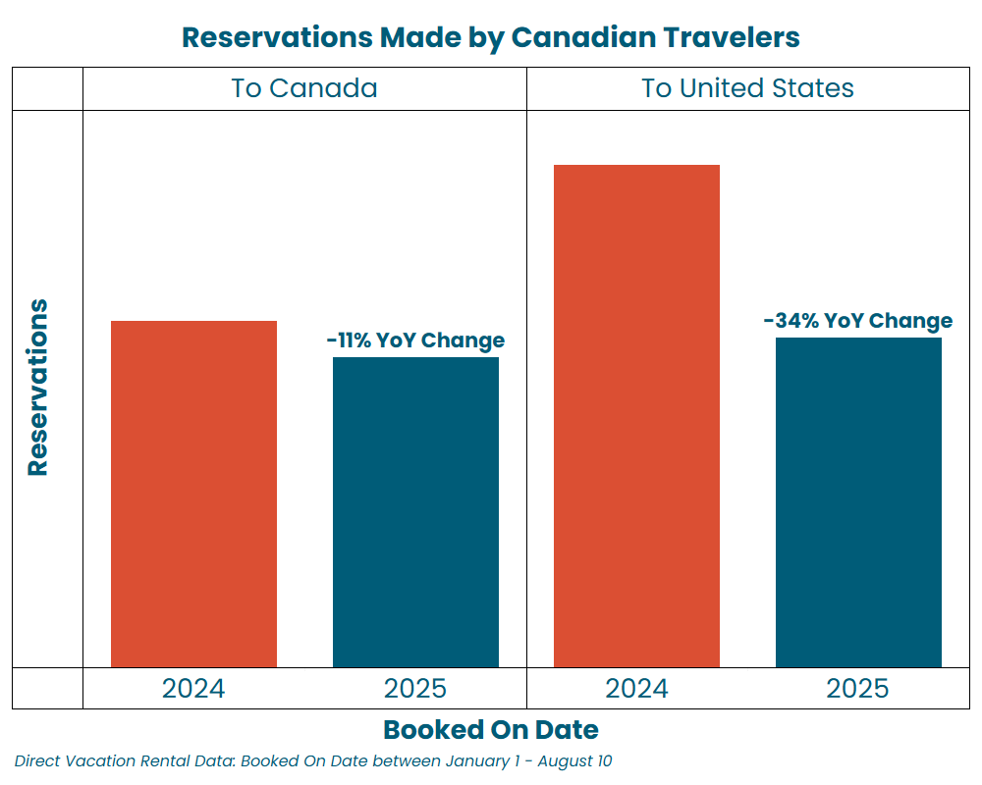
The Turning Tide of Travel
Shifts in travel patterns
The Age of Brochures
The Instant Traveller
Canada is the largest international feeder market for U.S. Vacation Rentals and the impact of the boycotts is obvious.
Domestic Canadian travel is down 11% YoY, reflecting overall softness in the Canadian travel economy.
Canadian Travel to the U.S. is down a significant 34%, displaying economic concerns, or geopolitical influences
Key Data direct clients, confirmed bookings January 1 - August 10

Slide 29
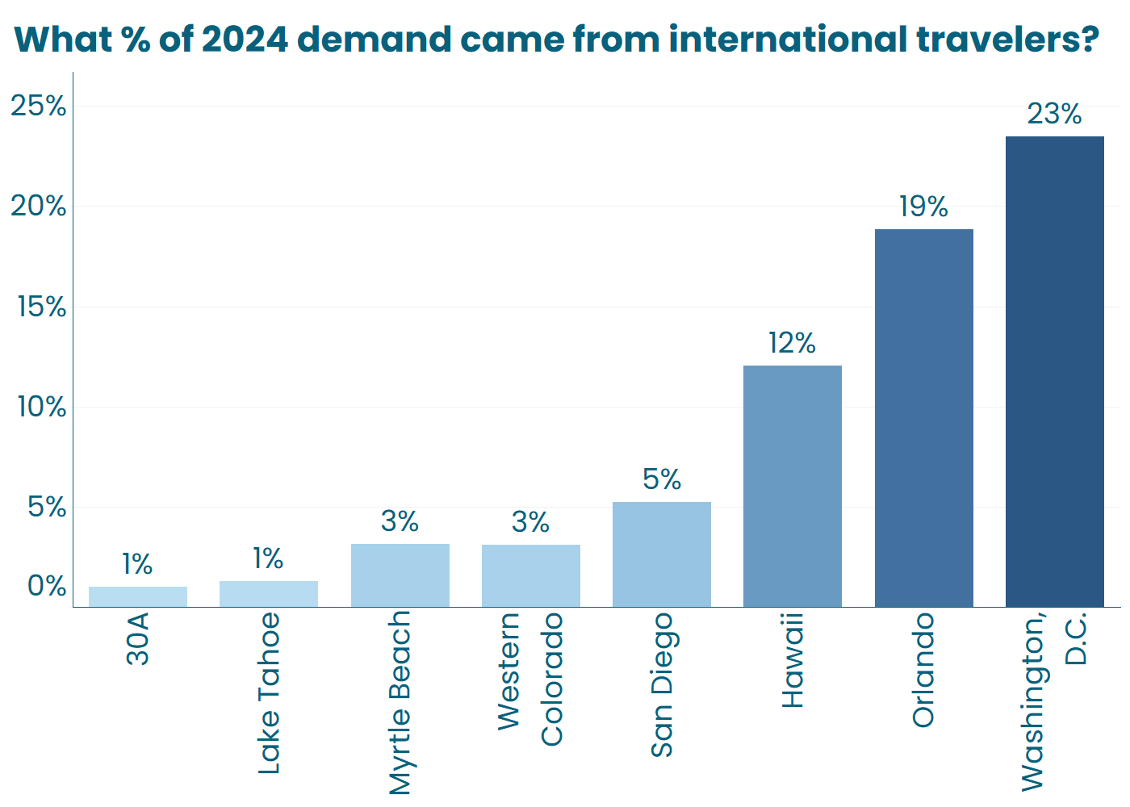
The Turning Tide of Travel
Shifts in travel patterns
The Age of Brochures
The Instant Traveller
While broader travel trends may seem concerning, it’s crucial to understand the specific dynamics of your market.
Some destinations, like Washington D.C., Orlando, and Hawaii, are more reliant on international travelers and may feel a sharper impact from any slowdown.
In contrast, markets like 30A and Lake Tahoe—with only 1% international demand—are less exposed to fluctuations in inbound international travel.
Key Data direct clients, confirmed bookings January 1 - August 10

Slide 30

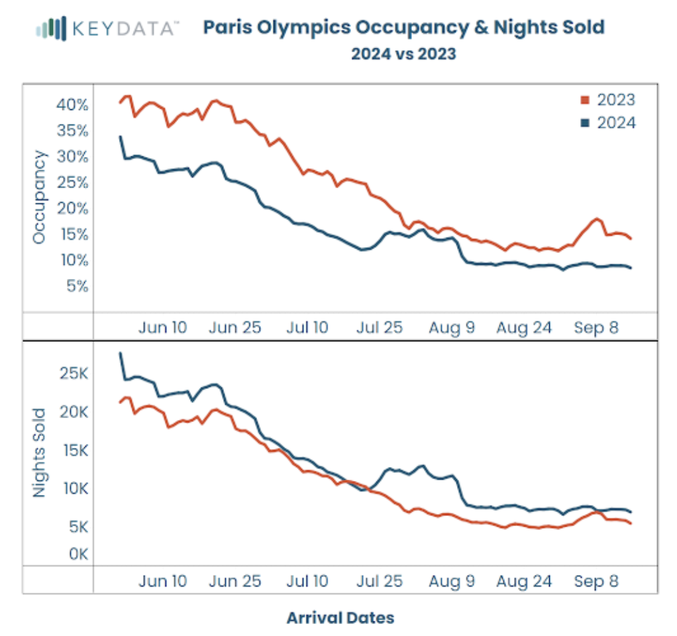
The Turning Tide of Travel
Events
The Age of Brochures
The Instant Traveller
Events - Scrutinise the Opportunity
24% drop in per property revenue - summer 2025
  Increase in supply (200%)
  Increase in demand (+229% falling to +166%) post month of Olympics.
34% more bookings but occupancy dropped; 21% to 15%
  Average booking window fell 31% to 22 days
  Average length of stay fell 21% to 3.9 days (-1 day)
Key Data direct clients, confirmed bookings @ 20th October 2025

Slide 31
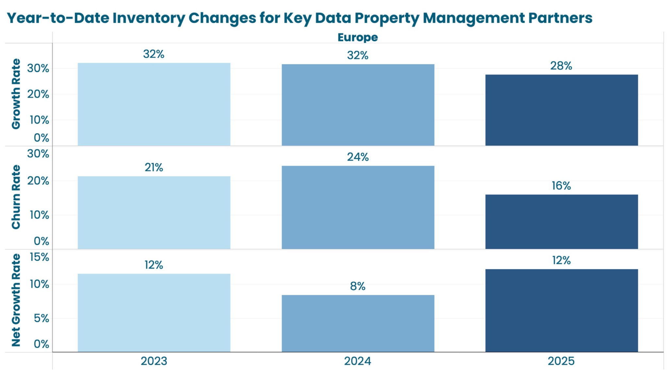
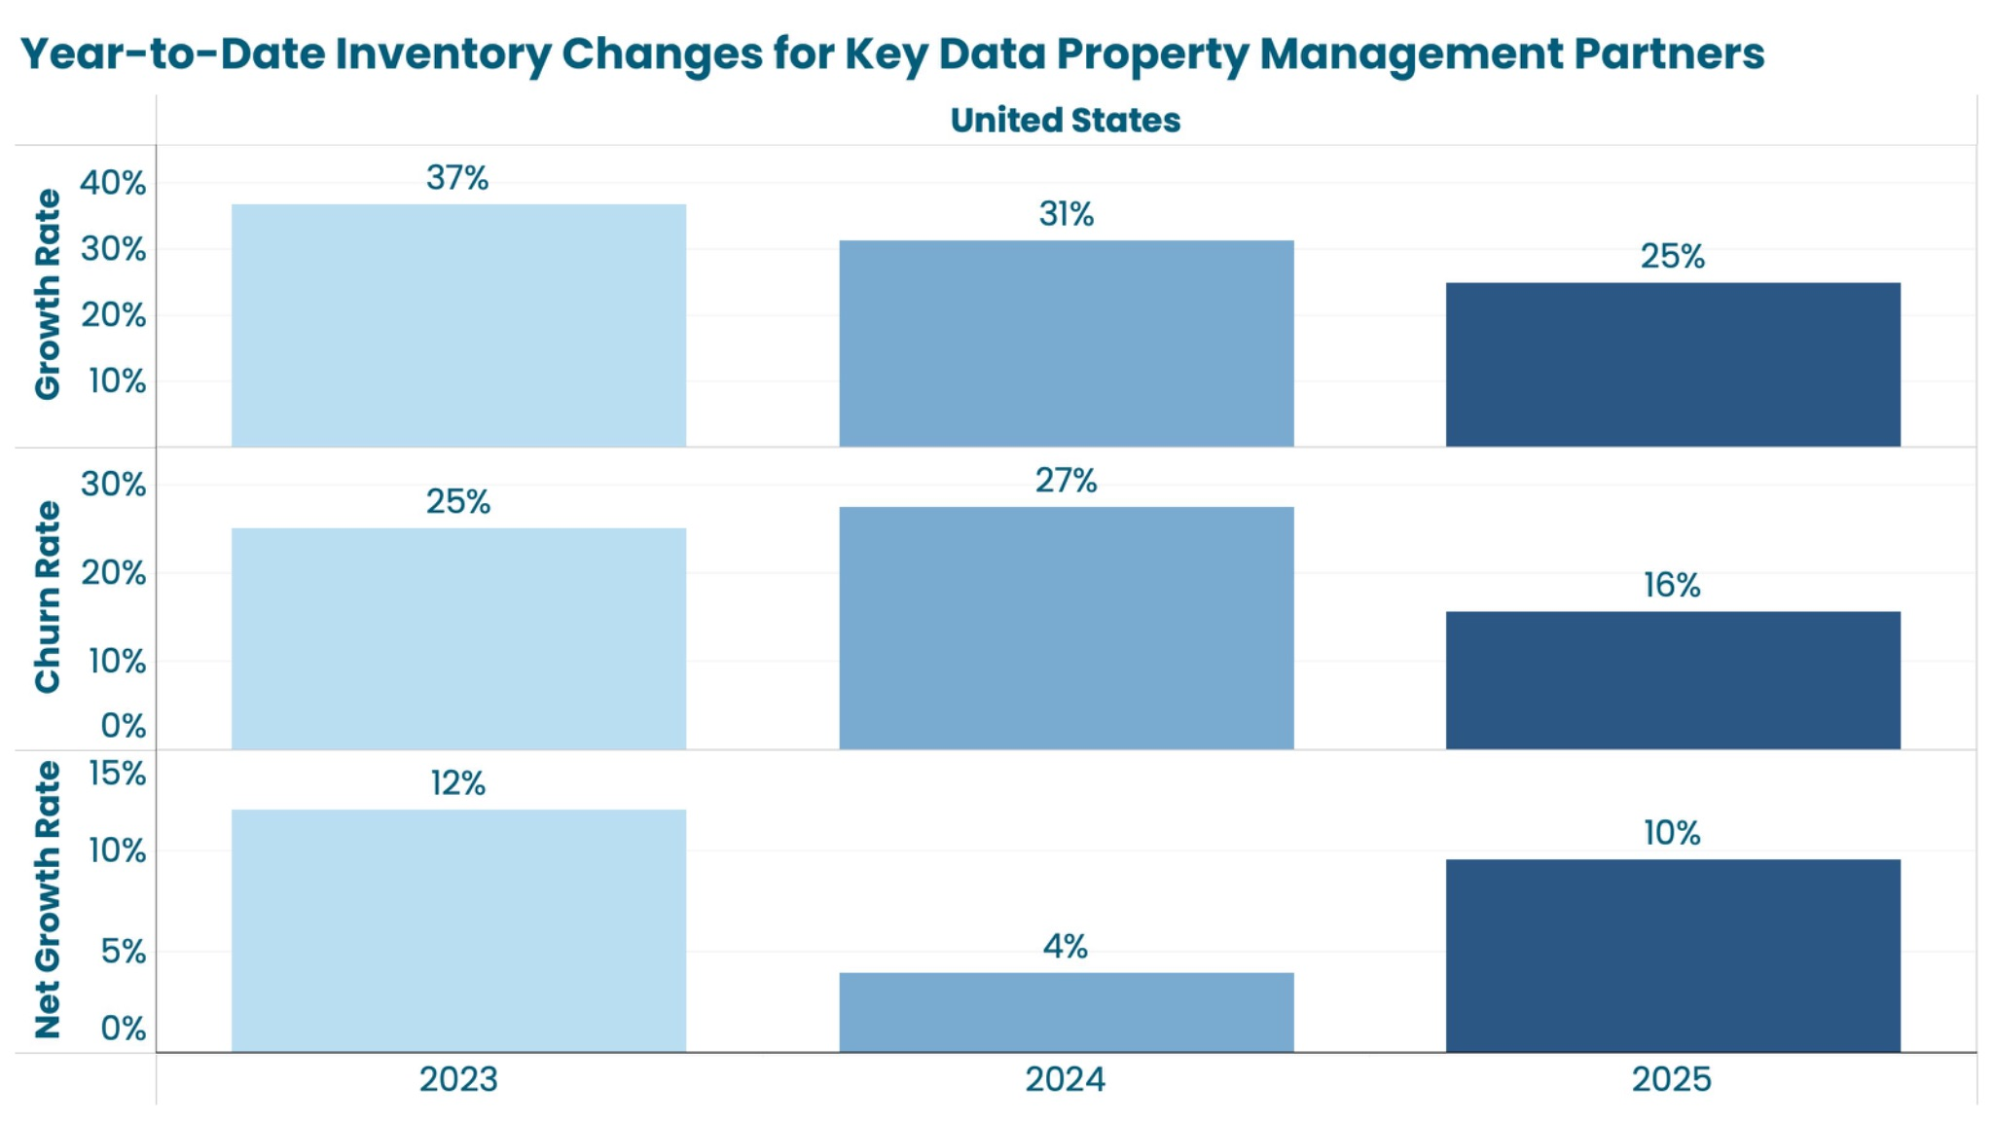
The Turning Tide of Travel
Events
The Age of Brochures
The Instant Traveller
Key Data property managers are seeing a net growth in their portfolio sizes in both Europe and the US.
Nett growth in Europe is back to 2023 growth, driven by reduced churn
Both European and US property managers, seeing an Improvement on 2024 inventory growth
Key Data direct clients, confirmed bookings @ 20th October 2025

Slide 32




Slide 33
The Final Chapter -
Key Takeaways
Guest demand is broadly flat
Rates are holding firm and keeping RevPAR steady
  Rate discipline and agility is required.
Booking windows are getting shorter with some very last minute bookings.
  Educate your owners, understand the pacing for ‘your’ portfolio
Guests are staying for less time. But they are still travelling.
  Have a gap night strategy and understand this impact on your operations.
The OTAs are gaining share at the expense of direct
  Ensure you are optimised to have all demand levers at your disposal.
The market is sensitive
  Geo-political climate, regulations and the economy will impact our industry
  Use data to help understand your data story
The Age of Brochures
The Instant Traveller
Key Data direct clients, confirmed bookings @ 20th October 2025

Slide 34



Thank you
sally.henry@keydatadashboard.com

